Slide 1
MENTAL HEALTH IN TECH SURVEY
A DATA MINING APPROACH
EM-623-DATA SCIENCE AND KNOWLEDGE DISCOVERY
AARTHI SHUNMUGAM

Slide 2
introduction
Mental health includes our emotional, psychological, and social well-being.
It affects how we think, feel, and act. It also helps determine how we handle stress, relate to others, and make choices.
Mental health is important at every stage of life, from childhood and adolescence through adulthood.

Slide 3
Why mental health important?
Mental health strengthens and supports our ability to:
have healthy relationships
make good life choices
maintain physical health and well-being
handle the natural ups and downs of life
discover and grow toward our potential

Slide 4
Business understanding
Mental Health is Good for Businesses
Businesses benefit when employees have good mental health.
Why?
Mental health is associated with higher productivity, better performance, more consistent work attendance, and fewer workplace accidents.
By eliminating the causes of productivity loss, absenteeism, and worker accidents, mental health of employees increase a company's efficiency, productive capacity, and quality of goods and services.
How do we determine the mental health of an employee?

Slide 5
Data understanding
Dataset information: This dataset is from a 2014 survey that measures attitudes towards mental health and frequency of mental health disorders in the tech workplace.
Source: https://www.kaggle.com/osmi/mental-health-in-tech-survey
Purpose: By analyzing this data the Employers can strengthen and safeguard their businesses by choosing employee health plans with strong mental health benefits.
Dataset Specifications:
1260 observations representing the employees.
27 variables or statistics information regarding each employee.

Slide 6
Data understanding
Out of 27 variables, not all variables contain relevant information. Also, some variables contain NA values or NULL values, which is of no use and should be cleaned.
Some values are misplaced, For example: the values of date and time are seen in the column which represent the number of employee. In this case, both the information is not important for prediction.
To find the important attributes of the dataset
Analyze the quality of data.
Skim the data and find out necessary columns/rows and important context of the data.

Slide 7
Data understanding
Variables that are important:
Family history (inherited mental illness )
Personal profile (such as AGE, GENDER)
Medical benefits and leave (provided by the employer)
Knowledge about the care options that the employer provides to employees.
Variables that are NOT important:
Attributes that contain missing values and NA values
Comments, interview about physical or mental consequence (these variables is not going to help in predicting whether he/she has sought treatment for mental illness before).
Co-workers mental health consequence and discussions is unrelated to the prediction.

Slide 8
Data preparation
Remove data that does not give any information that helps prediction.
Using Rattle remove the missing values and ignore the irrelevant attributes
Remove data that does not meet acceptable quality standards
• Over ~30%+ values are NULL, NA, Classified or blank
• Using Excel, replace filler cells with blank cells
• Using Rattle, identify variables that have many missing observations and remove them from the dataset
As the result of Data preparation by following the above steps we get
→ 1260 observations gets reduced to 616 observations after cleaning.

Slide 9
Data preparation
Remove the data that is unrelated to the prediction- For example
Comments stated by the employee which is too personal.
coworkers: Would you be willing to discuss a mental health issue with your coworkers?
Number of employees: How many employees does your company or organization have?
Observed-consequence: Have you heard of or observed negative consequences for coworkers with mental health conditions in your workplace?
After deleting the least important variables using Rattle
→ 27 variables got reduced to 23 variables.

Slide 10
Data preparation
Removing highly correlated variables is not going to affect the result or conclusion, since they have the same impact on prediction.
→ For example Wellness-program: Has your employer ever discussed mental health as part of an employee wellness program?
→ Seek-help: Does your employer provide resources to learn more about mental health issues and how to seek help? Both are more or less same!!
• Run correlation analysis
• Analyze correlation matrix
• Remove variables with identical or highly similar correlations with the rest of the dataset
→ 23 variables → 18 variables

Slide 11
DATA PREPARATION
TARGET VARIABLE:
→ Whether an employee has sought Treatment for a Mental condition
Possible values
→2 IF <1.5 YES (has undergone treatment, hence the probability of having mental illness is HIGH)
1 IF >1.5 NO (not sought treatment before, hence the chances of having mental illness is LOW)
However the probability of having mental illness also depends on the factor like Family history, Age and Gender etc..
→ if Family history has values like
1 (No, probability of having mental illness is low) and 2 (Yes, chances of having mental illness is high)

Slide 12
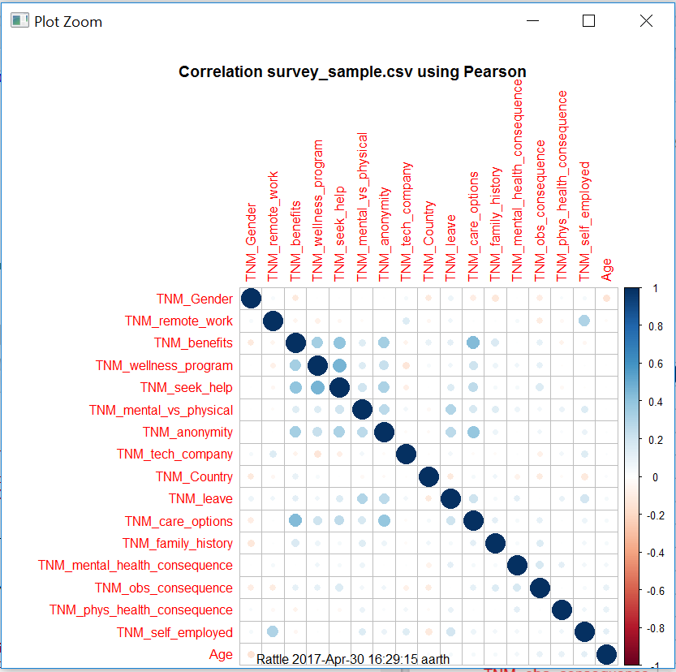
CORRELATION MATRIX

Slide 13
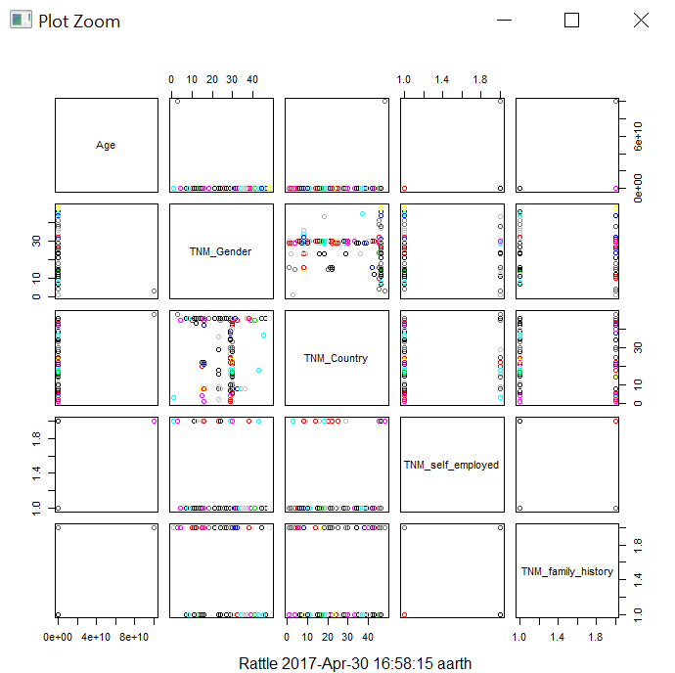
K – MEANS CLUSTERING

Slide 14
MODELLING
DECISION TREE MODEL
→ Identified objective, target variable – sought treatment or not for mental illness.
Model Parameters
• Min Split = 20
• Min Bucket = 7
• Max Depth = 30
• Complexity = 0.010

Slide 15
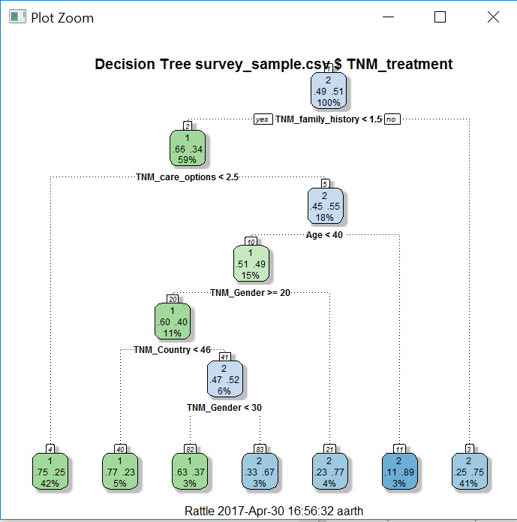
Modeling – decision tree

Slide 16
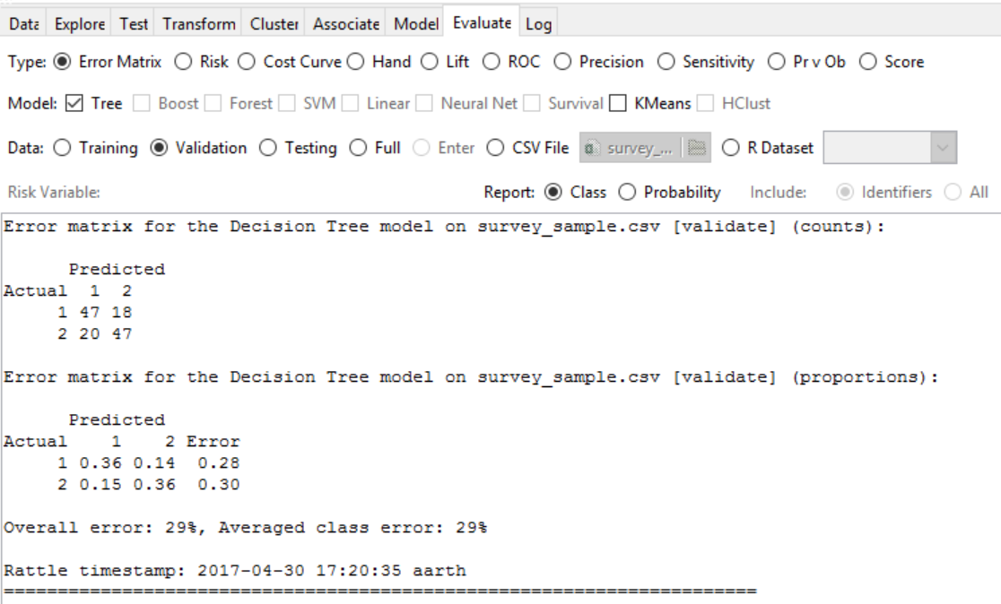
evaluation
So we have the model…
• Does it mean anything?
• Is it accurate and reliable?
Error Matrix
• Relatively decent at predicting
whether the employee sought Treatment
for mental illness.
Overall error is 29% and it can be improved.

Slide 17
evaluation
Receiver Operating Characteristic (ROC) Curve Plot
Visualize the model’s accuracy
Plots the model’s performance along true and false positives
Greater area under the curve (AUC) = better model performance
AUC = 0.71 which says the dataset is 71% accurate. (greater value of AUC more accurate the dataset is.)

Slide 18
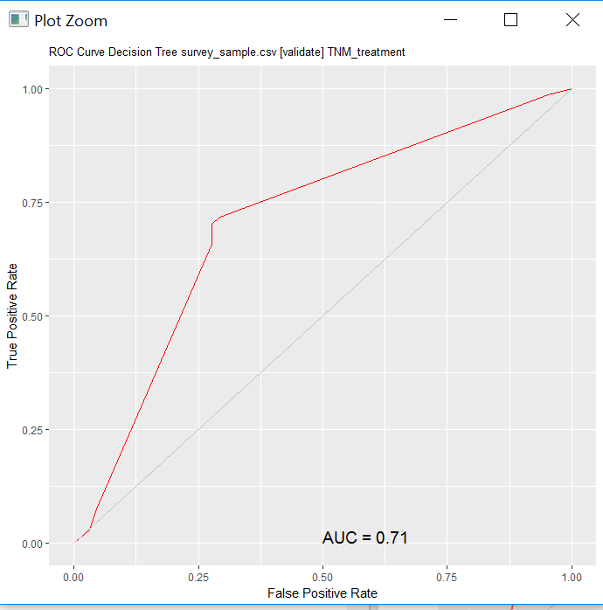
Evaluation – roc curve

Slide 19
CONCLUSION
According to the Model,
The employees who have family history of mental illness has high chances of getting mental illness.
The employees whose gender is male has high probability of having mental illness.
The employees who has the knowledge about the mental health care options that his/ her employer provides, is likely to have less mental issues.
→Overall many relevant variables are required to do the correct predictions and to increase the accuracy of the result.
→Also, some important variables such as work interfere is having many number of missing values, so we are in the situation to ignore that variable and was not considered for prediction, which decreases the accuracy of prediction.

